Slide 1

Systems for Scalable Graph Analytics and Machine Learning: Trends and Methods
Da Yan*, Lyuheng Yuan, Akhlaque Ahmad, Saugat Adhikari
yanda@iu.edu
Department of Computer Science
Luddy School of Informatics, Computing, and Engineering
Indiana University Bloomington
Notes:
Good morning everyone! Welcome to our tutorial titled “Systems for Scalable Graph Analytics and Machine Learning: Trends and Methods”.
This tutorial is contributed by two groups from Indiana University Bloomington and the Chinese University of Hong Kong.
My name is Lyuheng Yuan from Indiana University Bloomington.
This tutorial is supposed to be delivered by 2 or 3 people, since it's a 3-hr tutorial. But unfortunately, there's some visa issues with the other authors, so I will be presenting all the materials in this long tutorial.
So hopefully you will enjoy this tutorial and don't get bored with the material.

Slide 2
Tutorial Outline
Subgraph Mining & Querying
Structure Analytics (2 hrs)
Graph Neural Networks (1.5 hrs)
Graph Deep Learning
From the Systems Perspective!
Notes:
This tutorial is divided into two parts.
The first part is on structure analytics, which are based on conventional graph algorithms and graph mining methods,
The second part is on systems for training graph neural networks, which is a very hot topic right now.

Slide 3
(Distributed Training of GNNs)
Graph Neural Networks
Da Yan yanda@iu.edu
Notes:
Good morning everyone! Welcome to our tutorial titled “Systems for Scalable Graph Analytics and Machine Learning: Trends and Methods”.
This tutorial is contributed by two groups from Indiana University Bloomington and the Chinese University of Hong Kong.
My name is Lyuheng Yuan from Indiana University Bloomington.
This tutorial is supposed to be delivered by 2 or 3 people, since it's a 3-hr tutorial. But unfortunately, there's some visa issues with the other authors, so I will be presenting all the materials in this long tutorial.
So hopefully you will enjoy this tutorial and don't get bored with the material.

Slide 4
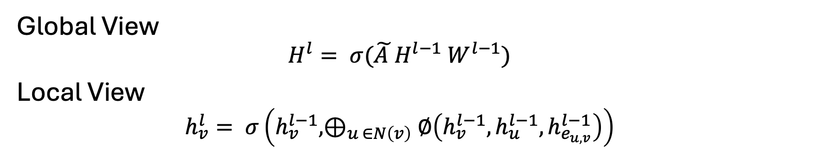
Graph Neural Networks (GNNs)
Global View
$$H^{l}= σ(\tilde{A }H^{l−1} W^{l−1})$$
Local View
$$h_{v}^{l}= σ\left(h_{v}^{l−1}, ⊕_{u ∈N\left(v\right)}∅\left(h_{v}^{l−1},h_{u}^{l−1},h_{e_{u,v}}^{l−1}\right)\right)$$
* Forward Propagation Shown Only
Notes:
The training of GNN consists of 2 parts: forward propagation and backward propagation. We can understand the forward propagation from 2 perspectives. From the global view, we can use the normalized adjacency matrix times the vertex embedding of the current layer times the weight matrix and we can obtain the vertex embedding of next layer.
If we just focus on a single vertex, we can use the concept of message passing to describe this process. For each neighbor of the vertex, we let the neighbor’s feature pass a dense layer, Since a vertex may have multiple neighbors, we aggregate the output of its neighbors into a single feature vector. Then we concatenate it with the feature of the vertex itself, pass another dense layer, and we obtain the feature of next layer.

Slide 5
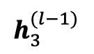
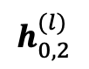
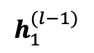
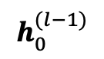
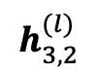
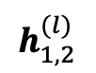
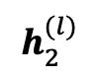
Graph Neural Networks (GNNs)
$$h_{0}^{(l−1)}$$
0
$$h_{0,2}^{(l)}$$
2
3
Aggregate
$$h_{1}^{(l−1)}$$
1
$$h_{1,2}^{(l)}$$
A
2
$$h_{2}^{(l)}$$
0
1
$$h_{3}^{(l−1)}$$
3
$$h_{3,2}^{(l)}$$
Original Graph
Forward Computation
Notes:
Let’s use a more concrete example to illustrate the forward propagation. Suppose we want to compute the feature of vertex 2 in the original graph, we can observe that vertex 2 has 3 incoming neighbors, 0, 1 and 3. [CLICK]
So we first get the features of 0, 1 and 3, and let them pass a dense layer and we can get the corresponding features for 3 incoming edges. [CLICK]
Then we will aggregate these 3 edge features into a single feature vector. [CLICK]
And we let this feature pass another dense layer and the final output is the feature of vertex 2.

Slide 6
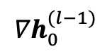
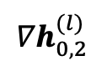
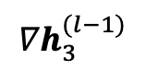
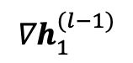
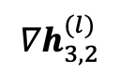
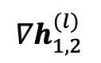
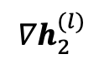
Graph Neural Networks (GNNs)
$${∇h}_{0,2}^{(l)}$$
0
$${∇h}_{0}^{(l−1)}$$
Scatter
2
3
2
$${∇h}_{2}^{(l)}$$
2
S
$${∇h}_{1,2}^{(l)}$$
1
$${∇h}_{1}^{(l−1)}$$
0
1
$${∇h}_{3,2}^{(l)}$$
$${∇h}_{3}^{(l−1)}$$
3
Original Graph
Backward Computation
Notes:
The backward propagation is very similar to the forward propagation.
Suppose we have the gradient of vertex 2 and we want to compute the gradient of vertex 2's incoming neighbors, 0, 1, 3. [CLICK]
Firstly we do a matrix multiplication on input gradient and get an intermediate result S. [CLICK]
And then we do a scatter operation to scatter S onto 3 incoming edges and we get the gradient of 3 incoming edges.
[CLICK]
Finally we do another matrix multiplication on the edge gradient and we can get the gradient of 3 incoming neighbors.

Slide 7

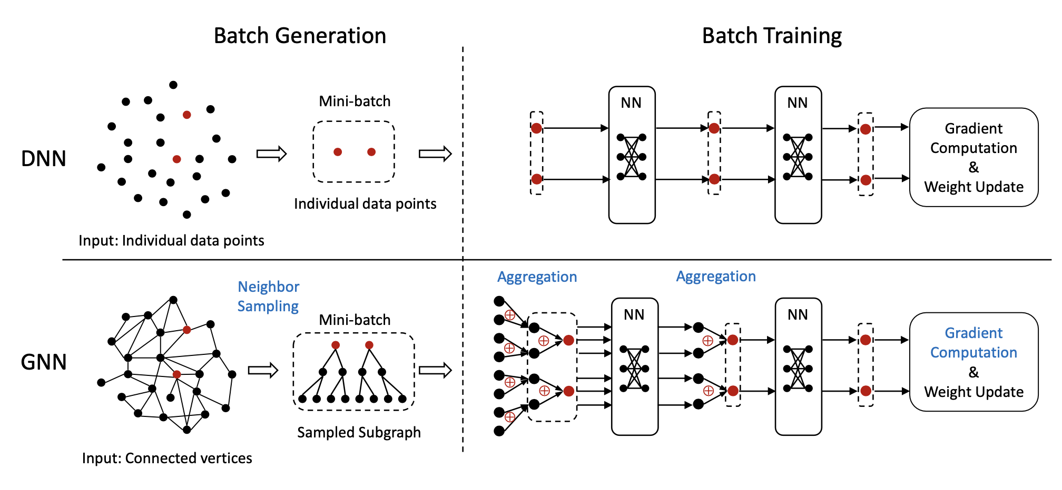
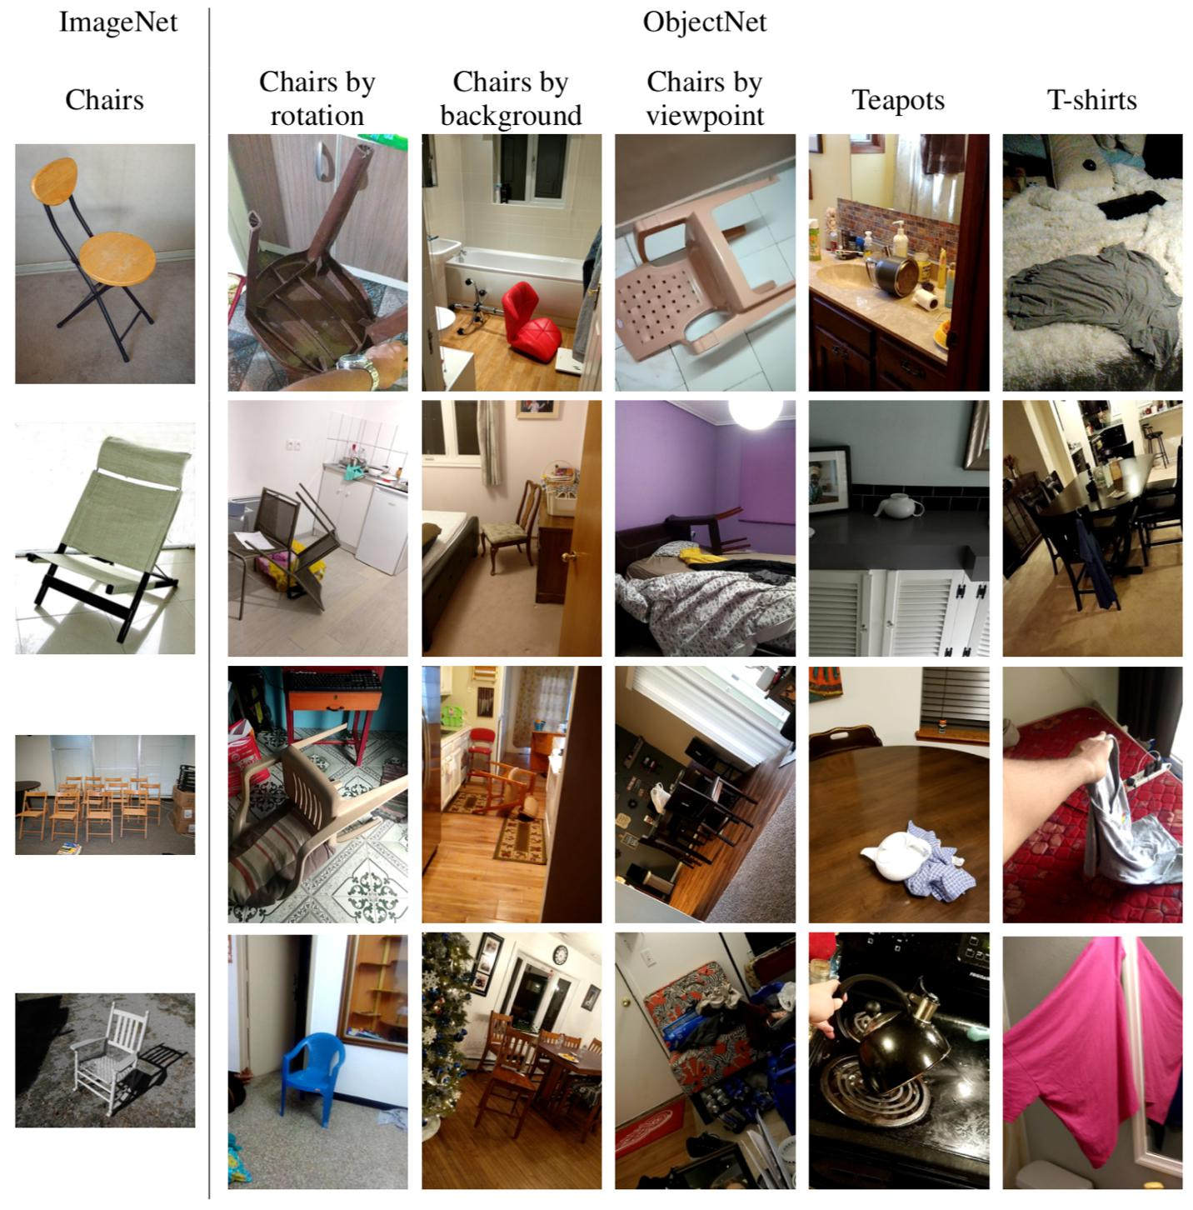
Differences to DNNs
GNNs require L-hop neighborhood.
Additional aggregation & scattering operations.
Notes:
Now let's take a look at some of the major differences between GNN and Deep Neural Network, DNN.
In normal DNNs, suppose every data point is an image, we can sample a mini-batch of these images. In the following propagation, every computation only depends on the data in the mini-batch or pixel values.
[CLICK]
However, in the GNN training, it's quite different. [CLICK]
The forward propagation of a vertex relies on the feature from its neighborhood. If a GNN has L layers, then we must obtain the features from its L-hop neighborhood. This requirement makes GNN training an IO-intensive problem which may become a bottleneck.
[CLICK]
Secondly, as I mentioned earlier, there're 2 special operations that don't exist in DNN training, which are aggregation and scattering. Therefore, we need to make additional efforts in optimizing these 2 operations if we want to achieve efficient training.

Slide 8
Approaches to GNN Training
Mini-batch GNN training
+ Reduce computation, memory and IO demands by sampling
Lower accuracy
AliGraph [VLDB’19], P3 [OSDI’21], Dorylus [OSDI’21]
ByteGNN [VLDB’22], BGL [NSDI’23], …
Full-graph GNN training
+ No accuracy loss
High demand for computation, memory and IO
DistGNN [SC’21], NeutronStar [SIGMOD’22], Sancus [VLDB’22]
AdaQP [MLSys’23], MGG [OSDI’23], HongTu [SIGMOD’24], …
Notes:
There're basically 2 main approaches to training a GNN, namely mini-batch GNN training and full-graph GNN training. For mini-batch training, we sample a mini-batch of vertices and their neighbors. If the size of neighbors is very large, we usually sample part of their neighbors as the training data. Of course the sampling can reduce large amount of computation and IO workload, but it turns out the accuracy may be sacrificed, which is found and proved by researchers in the AI community.
On the other hand, full-graph training has no accuracy loss, but it has higher demand in computation and IO, since we must take every neighbor into consideration so the workload compared to mini-batch training is much larger.
[CLICK]
In the tutorial, we will cover several works from both categories publish in last 5 years, and we will talk more on these works later.

Slide 9
Agenda
Why Distributed & Challenges
Mini-batch GNN training
Full-graph GNN training
Communication Optimizations
Staleness Tolerance
Optimizations on GPU

Slide 10
Distributed GNN Training
Why Distributed?
High parallelism for computation
Many CPUs, each with multi-core parallelism
Many GPUs, each with thousands of CUDA threads
Insufficient memory for vertex embeddings
Large graph size
High input embedding dimension
Limited GPU device memory
Notes:
The first question is why we're interested in distributed GNN training and why it is important.
[CLICK]
A very straightforward answer is it offers high parallelism for computation. A modern cluster usually has 100 of machines and with so many CPU cores, we can achieve multi-core parallelism.
A modern GPU has thousands of cuda cores, and is very efficient in computing matrix multiplication. Training GNN requires large amount of matrix multiplications. So if we know how to use multiple GPUs together, we can achieve massive parallelism and a very efficient training pipeline.
[CLICK]
Another reason would be insufficient memory space for vertex embeddings.
Nowadays, the size of graph is increasing to 10 billions of edges or even larger. Storing the graph itself requires a large storage. Besides, some embedding dimension can reach to 1000, and with so many vertices/edges, storing embeddings needs additional storage. However, GPU memory is always an scarce resource. For example, A100 GPU only has 40/80 GB so it's really insufficient comparing with such large amount of training data. If we have multiple machines/devices, we can collectively use their memory space, which will be more flexible and effcient.

Slide 11
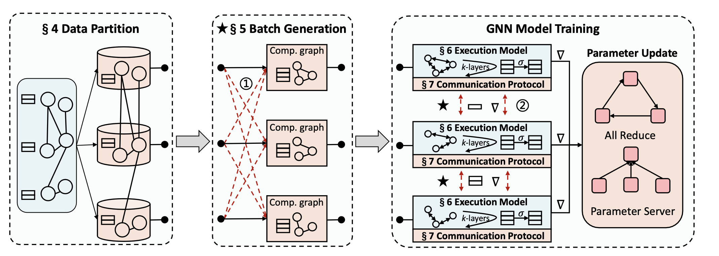


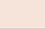
Distributed GNN Training Pipelines
Notes:
This slide shows the pipelines of distributed GNN training. Firstly we have data partition or graph partition. Since we are talking about distributed training, we want each device to maintain part of graph or a subset of vertices and their corresponding features.
[CLICK]
Next we have a step called batch generation if we're doing mini-batch GNN training. Since the training data of one mini-batch may come from multiple machines, so we need to request each of those machines and wait until the dependent data is received.
But if we are doing full-graph GNN training, this step is skipped.
[CLICK]
The final step is called GNN model training. the training consists of forward propagation. loss computation, backward propagation, and weight updates. We'll focus on the exeuction model in the training and we'll also cover communication protocal & optimization in later slides.

Slide 12
Challenges in Dist. GNN Training
Massive embedding communication
Overlap communication & computation [NeutronStar]
Avoid redundant IO [HongTu]
Adopt faster link [DGCL]
Staleness-aware broadcast [Sancus]
Model parallelism [P3]
(De)Quantization [AdaQP]
…
Notes:
Now let's talk about the challenges in dist. GNN training.
As we've already know, the communication is always a major bottleneck in dist GNN training, how to handle such large amount of data communication is a key challenge to handle.
[CLICK]
A number of existing works came up with some solutions to fix this issue, such as 1.2.3.4.5 and so on. We will talk about these works in detail.

Slide 13
Challenges in Dist. GNN Training
Imbalanced workloads, stragglers
Heuristic cost model [BGL, ByteGNN]
Graph partitioning
Vertex-cut [DistGNN]
Edge-cut [NeutronStar]
METIS [DGCL]
Adjacency-matrix partitioning [Sancus]
Feature partitioning [P3]
…
Notes:
Another challenge is the imbalance workloads or stragglers. If we have multiple machines to use, how to evenly assign the workload to multiple machines is an important problem because we don't want one machine does most of the work while others just being idle. Straggler problem almost happens in all distributed computing problems.
[CLICK]
In the context of GNN training, a series of existing works proposes different ways to do the workload assignment, including 1, 2, ,3 4 and so on. We will talk about these works in detai as well.

Slide 14
Agenda
Why Distributed & Challenges
Mini-batch GNN training
Full-graph GNN training
Communication Optimizations
Staleness Tolerance
Optimizations on GPU

Slide 15
Distributed GNN Training Pipelines
Notes:
Now let’s talk about graph partitioning.

Slide 16
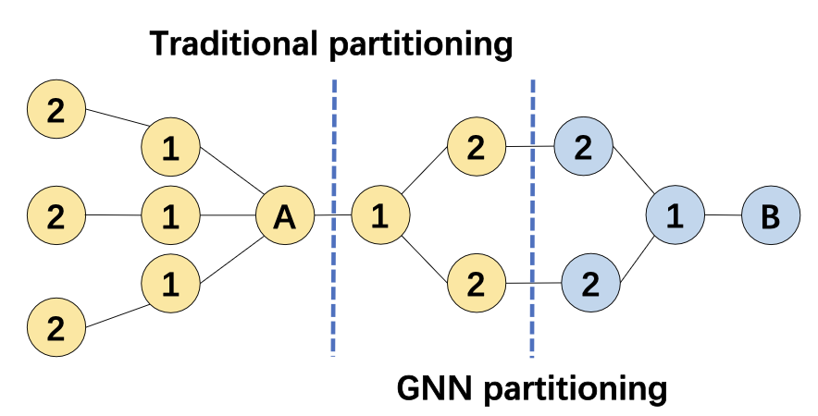
Graph Partitioning
Vertex-cut, edge-cut, METIS are commonly used
Heuristic cost models also help
Figure from ByteGNN [VLDB’22]
Notes:
Graph partitioning is not a very severe problem in GNN training. Many existing works just use off-the-shelf solution for partitioning the input graph, such as vertex-cut, edge-cut and METIS. But some works still have some insight on this problem. For example, METIS is a graph partitioning algo. aiming to minimizing the number of cross-partition edges. Suppose we use METIS on this graph, the cut is in blue dashed line since there's only 1 cross-partition edge. But A and B in red circle are 2 training vertices,
[CLICK]
we may cut this way since yellow partition is the 2-hop neighborhood of the training vertex A and blue partition is the 2-hop neighborhood of B, which means we don't need to have any communication between 2 partitions when training A and B.
Therefore, we might need some heuristic cost models to estimate the workload.

Slide 17
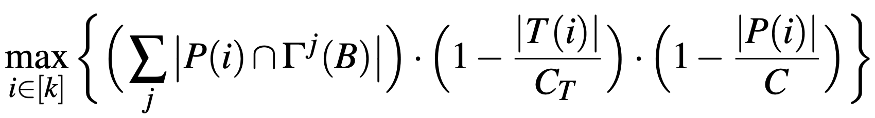
Graph Partitioning
BGL [NSDI’23] introduces a heuristic for vertex assignment
# of training nodes
assigned to partition i so far
# of nodes assigned to
partition i so far
Avg # of training nodes
per partition
Avg # of nodes
per partition
Current partition
j-hop neighbors
* B is a vertex block to be assigned to a worker
Notes:
BGL in NSDI'23 introduces the following heuristic model for vertex assignment.
Let's first figure out what each term stands for.
[CLICK]
Gamma^j (B) stands for the j-hop neighbors of a vertex block B. A vertex block is a set of vertices that are closely connected in the original graph, usually consists of 100 to 10k vertices. P(i) stands for the current partition with index i we are looking at. The intersection in between means the cross edge connecting the vertex block and the current partition. This term represents the cohesiveness of 2 subgraphs. And the summation means we're first considering 1-hop, then 2-hop, 3-hop and so on.
[CLICK]
CT and C stands for the average # of training nodes and nodes per partition.
[CLICK]
On the nominator side, T(i) is # of training nodes assigned to partition i so far.
and P(i) is # of nodes assigned to partition i so far.
These 2 terms encourages each partition to have roughly equal # of training nodes and node. These 2 term will penalize those partitions with more nodes than average being assigned already.
For each vertex block B, we will select a partition i such that this heuristic is maximized, and vertex block is then merged into the partition.

Slide 18
Distributed GNN Training Pipelines
Notes:
Now let's look at the batch generation step.

Slide 19
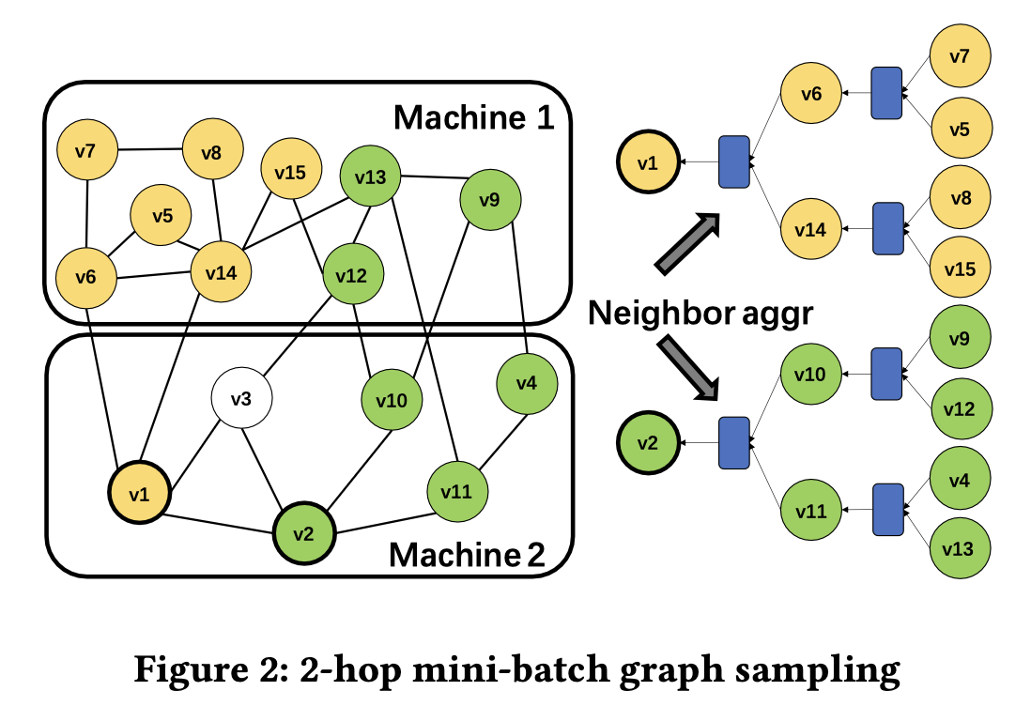
GNN Batch Generation
From ByteGNN:
D₁ = 25, D₂ = 10 is good enough.
Sample D₁
neighbors
Sample D₂
neighbors
Mini-batch Neighborhood Sampling
Seed vertex
Figure from ByteGNN [VLDB’22]
Notes:
A simple and straightforward way to do the sampling is
[CLICK]
we first select some seed vertices, v1 and v2 in this case.
[CLICK]
Then we look at the neighbors of seed vertex, select at most D1 out of the neighbors. For example, v1 has 4 neighbors, but only 2 of them are selected.
[CLICK]
Next we iterate this process for the vertices selected in last round. [V6] If the number of neighbors is greater than a threshold, we only select part of them.
[CLICK]
From ByteGNN paper in VLDB'22, if you choose d1= 25 and d2 = 10 you can get emmprically good results, but there's no rigorious guarantee for this conclusion.

Slide 20
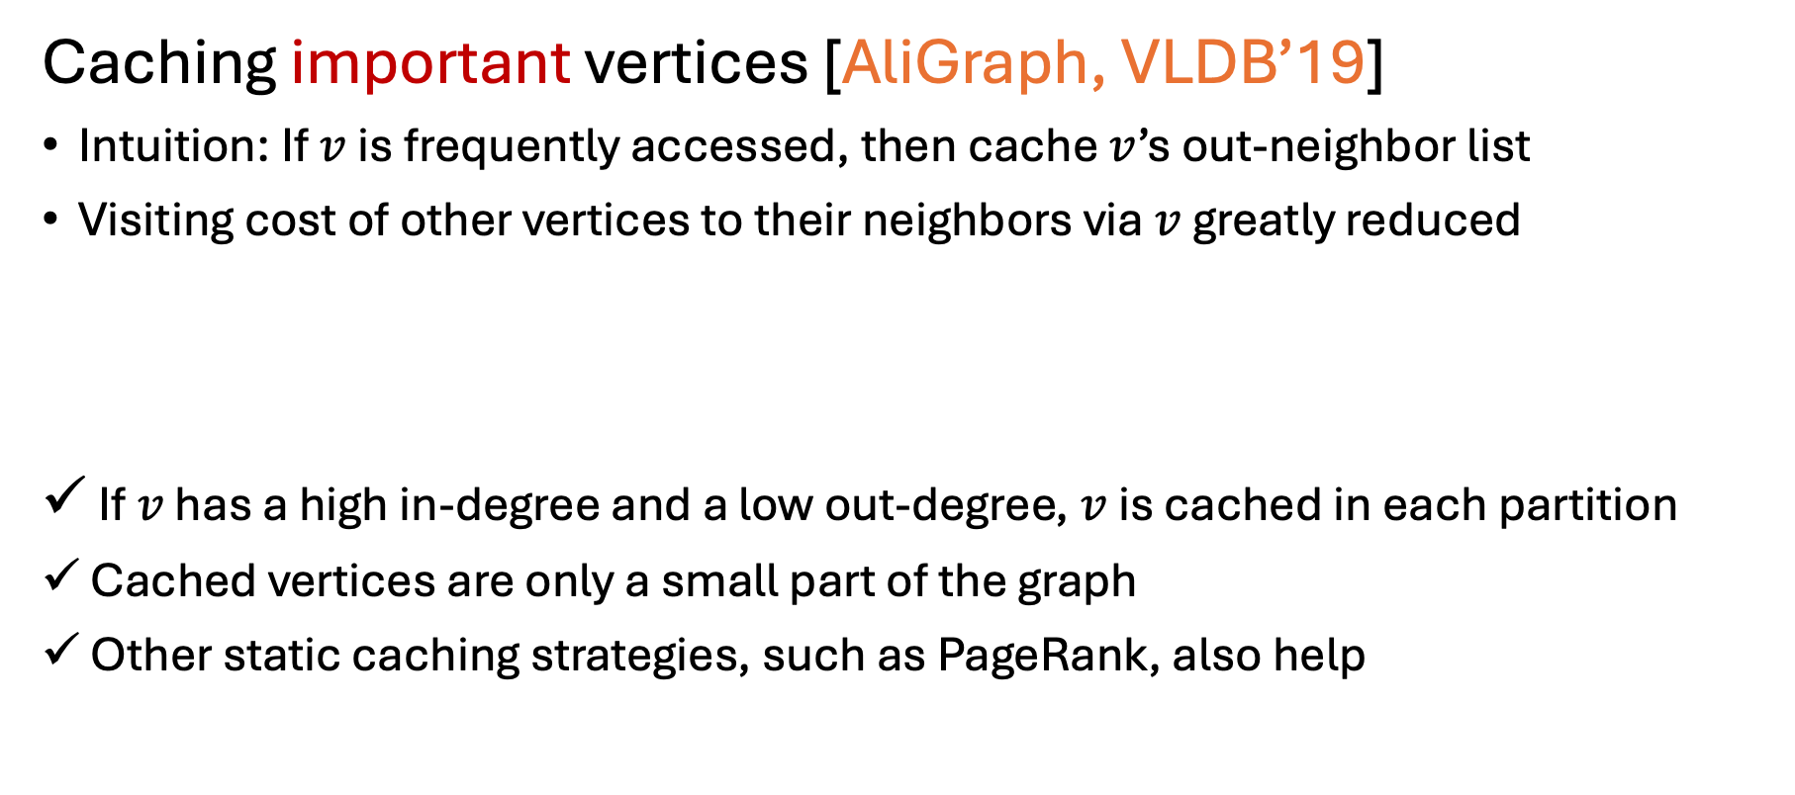
GNN Batch Generation
Caching important vertices [AliGraph, VLDB’19]
Intuition: If $v$is frequently accessed, then cache $v$’s out-neighbor list
Visiting cost of other vertices to their neighbors via $v$ greatly reduced
If $v$ has a high in-degree and a low out-degree, $v$ is cached in each partition
Cached vertices are only a small part of the graph
Other static caching strategies, such as PageRank, also help
Notes:
In general, there might be some vertices that is frequently accessed in the batch generation. In Aligraph paper in VLDB'20, they proposed to cache these frequently accessed vertices locally. In their definition, they call such vertices important vertices.
The intuition is if a vertex is important, then I should cache its out-neighbors, so that the other vertices can easily obtain their 2-hop neighbors through this important vertex.
[CLICK]
In their paper, they introduce a factor defined as in-degree divided by out-degree to describe how important a vertex is.
If a vertex has high indegree and low out-degree, then v will be cached.
[CLICK]
Cached vertices are only a small part of the graph, so the cache won't take a large amount of space.
[CLICK]
Other static cache strategies, such as pagerank also works where you first run a pagerank algorithm, and every vertex ends up with a score. You can use this score to measure whether you want to cache it or not.

Slide 21
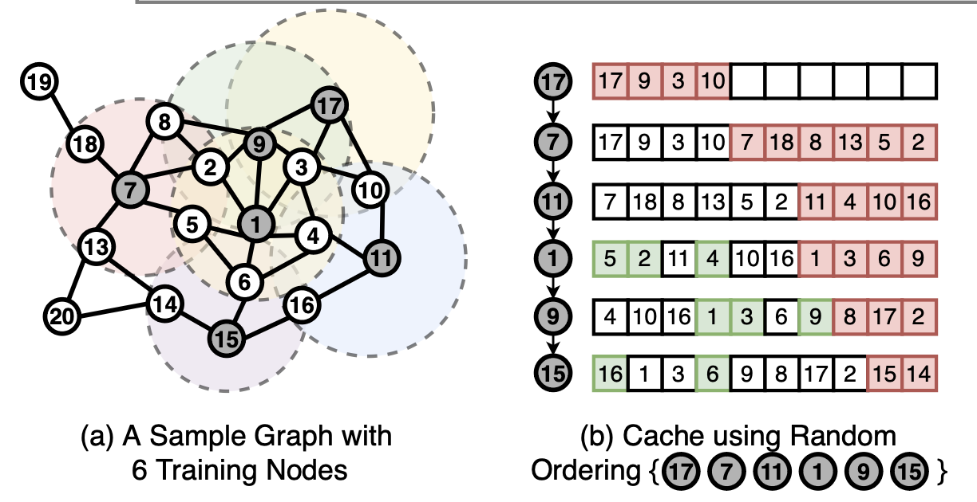

GNN Batch Generation
What about dynamic caching?
BGL [NSDI’23] applies FIFO policy
Low cache hit rate!
17, 7 and11 are far from each other!
Notes:
Then what about dynamic cache? This paper BGL applies FIFO policy as their cache strategy.
[CLICK]
Suppose the current mini-batch contains these 6 vertices pointed by the red arrow, and we use a random order to fetch their neighbors and also features.
[CLICK]
First we put 17 and its neighbors into the cache.
[CLICK]
Then we put 7 and its neighbors into the empty space of the cache.
[CLICK]
Next we put 11 and its neighbors into the cache. Since the number of cache vertices is limited, some vertices are evicted from the cache.
[CLICK]
we can observe that the first 3 vertices has no common neighbors at all, which means the cache hit ratio is really low since not a single vertex is read from cache.
[CLICK]
The reason is the first 3 vertices 17, 7 and 11 are far from each other in the input graph, so they share very few common neighbors.
So next question is how to improve the cache hit?

Slide 22

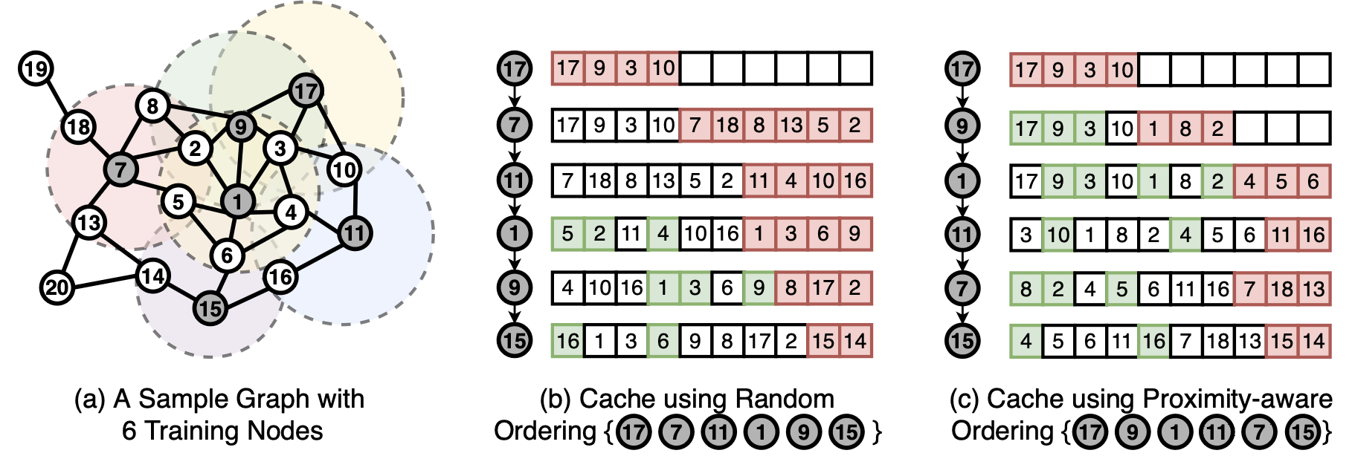
GNN Batch Generation
BGL [NSDI’23] proposes Proximity-Aware Ordering (PO)
High cache hit rate!
BFS ordering
Notes:
To resolve this low cache hit issue, BGL proposes Proximity-aware ordering or PPO.
[CLICK]
If we use the BFS ordering rather than random ordering,
[CLICK]
Firstly, we put 17 and its neighbors into the cache.
[CLICK]
Then we put 9 and its neighbors into the cache because 9 is in the 1-hop neighborhood from 17. The good news is that 3 neighbors are already in cache, so we can directly use it.
[CLICK]
Then we put 1 and its neighbors, because 1 is in 2-hop neighborhood.
[CLICK] [CLICK] [CLICK]
Then 11 and 7 and lastly 15.
[CLICK]
We can observe much higher cache hit ratio using PPO/BFS ordering compared to random ordering since we take the connectivity of the vertices into account.

Slide 23
GNN Batch Generation
But PO violates the i.i.d. requirement of SGD
BGL [NSDI’23] also introduces randomness
Select BFS sequence in a round-robin fashion
BFS Seq #1
BFS Seq #2
BFS Seq #3
Notes:
However, PPO violates the i.i.d requirement of SGD, since we enforce a BFS ordering within a single mini-batch, but it's supposed to be a random order. Violating iid requirement would make the model hard to converge.
[CLICK]
To fix this issue, BGL also introduce randomness.
[CLICK]
where we can have 3 BFS sequence at the same time, and we can sample them in a round-robin fashion.
[CLICK]
For example, we first select some vertices in seq 1 and switch to seq 2, take some vertices and switch to seq 3. Then we iterate back to seq 1. This paper claims that you don't lose significant accuracy while in the meantime improving the cache hit.

Slide 24
Distributed GNN Training Pipelines
Notes:
Now let’s go through the last step model training and discuss the execution model in detail.

Slide 25
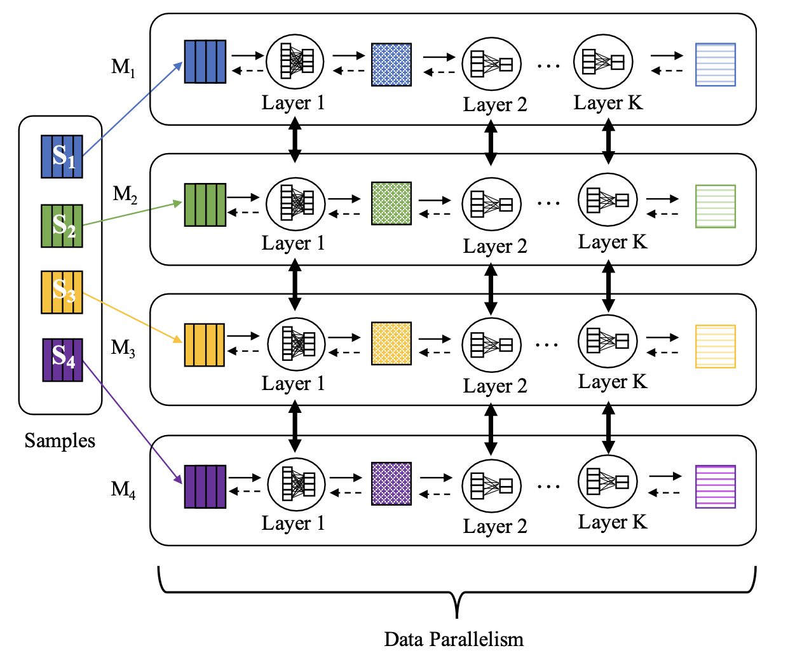

Mini-Batch GNN Execution Model
D
M1
M1
M2
M2
|V|
M3
M3
…
M4
M4
…
Embedding Matrix
Data Shuffling
k-hop subgraphs +
input features (~1k dimension)
Notes:
A widely used execution model is shown in the slide, where we first partition the embedding matrix horizontally. In other word, each machine holds the embedding of a subset of vertices.
Then each machine will be assigned with a mini-batches of training vertices, which may rely on multiple machines. So an all2all broadcast is required to communicate the sampled subgraph and the embeddings of its L-hop neighborhood.
After all the dependent data is received, each machine can continue forward propagation and backward propagation without any trouble. We call this as data parallelism where each machine is in charge of a different mini-batch.
[CLICK]
However, this all2all broadcast or data shuffling might be very time-consuming if the input feature dimension is very large, for example, up to a 1k.

Slide 26
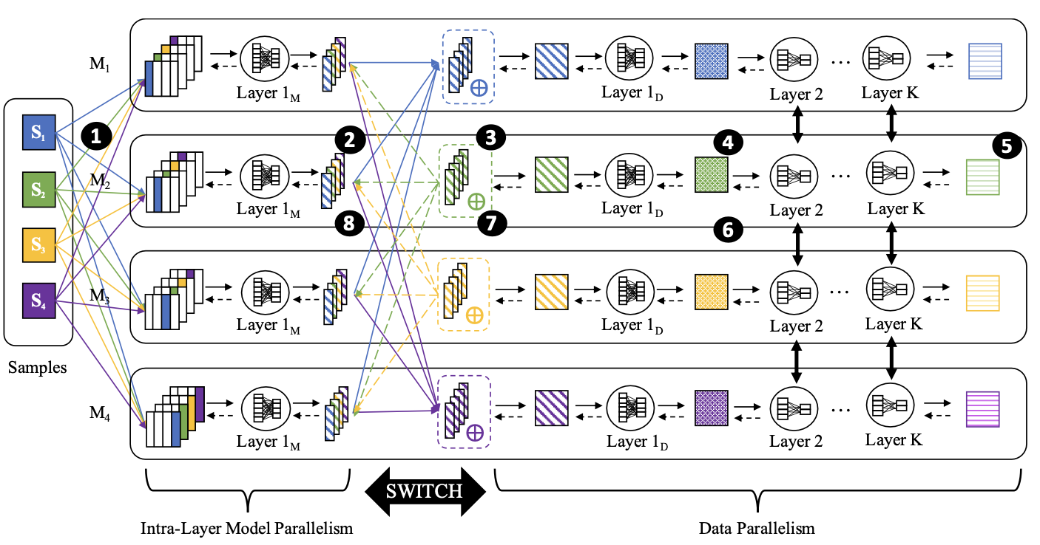
Mini-Batch GNN Execution Model
When input dim D >> hidden dim H
P3 [OSDI’21] introduces Push-Pull Parallelism
D
|V|
M1
M2
M3
M4
Embedding Matrix
shuffling k-hop subgraphs only
hidden features
(~100 dimension)
Notes:
This work called P3 in OSDI'21 introduces a different way of maintaining vertex embeddings.
Instead of horizontally split the embedding matrix, it vertically splits the matrix where each machine holds a partial embedding feature for all the vertices. For example, if the input dimension is 1k, then each machine will hold a vector of 250 dimension for each vertex.
[CLICK]
The benefit of such strategy is during the first all2all broadcast, we only broadcast the subgraphs itself, so the feature communication is completely avoided.
Then each machine will compute the first layer for 4 mini-batches, but the result will only be 1/4 of the total dimension.
[CLICK]
After the first layer is done, we do another all2all feature broadcasting to let each machine maintain a complete mini-batch. Remember than the feature being broadcast is just hidden feature, which often has far less dimension than the input feature, for example, 100. Then each machine will be in charge of a different mini-batch.
To summarize, in P3, first we have a model parallelism where we partition the workload w.r..t the dimension. Then we have an all2all broadcast, and then we switch to data parallelism. By doing this, the communication overhead will be significantly reduced.

Slide 27
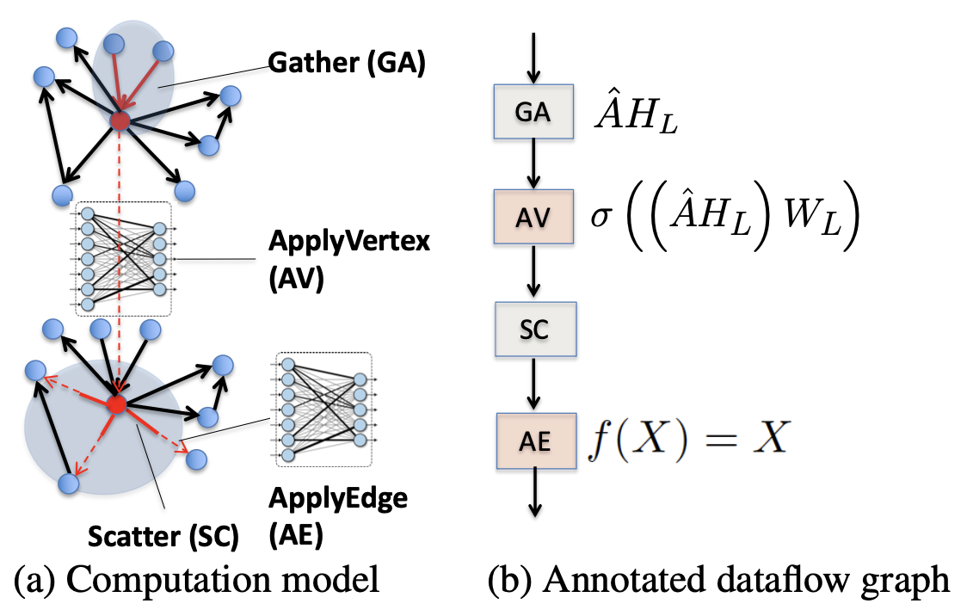
Mini-Batch GNN Execution Model
Dorylus [OSDI’21] abstracts dataflow graph in each forward layer
Figure from Dorylus [OSDI’21]
Notes:
Now let's talk about an asynchronous training pipeline.
Dorylus in OSDI'21 introduce an abstraction of the dataflow graph in each forward layer.
Firstly, we have gather to aggregate the feature of a vertex's neighborhood.

Slide 28
Mini-Batch GNN Execution Model
Dorylus [OSDI’21] abstracts dataflow graph in each forward layer
Figure from Dorylus [OSDI’21]
Notes:
Then we have ApplyVertex. We use this aggregated vector to multiply the weight matrix.

Slide 29
Mini-Batch GNN Execution Model
Dorylus [OSDI’21] abstracts dataflow graph in each forward layer
Figure from Dorylus [OSDI’21]
Notes:
Then we have scatter to distribute the result to its neighbors.
Finally, we have ApplyEdge.
In a simplified GNN model, ApplyEdge doesn’t do anything, its output is simply just input.

Slide 30
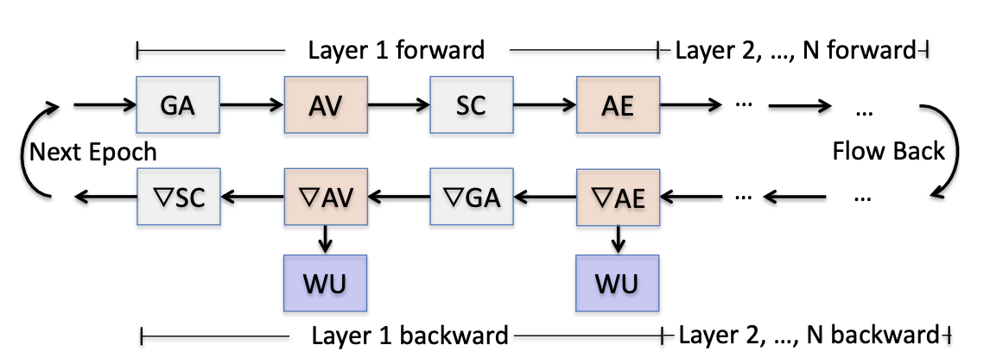
Mini-Batch GNN Execution Model
Dorylus [OSDI’21] splits each layer into individual tasks
Figure from Dorylus [OSDI’21]
Notes:
Dorylus splits the propagation of each layer into 9 individual tasks. On the last slide, we introduce 4 tasks in the forward propagation. For the backward propagation, we have another 4 tasks in the gradient version. Weight Update is also treated as a task.
Therefore the execution model is converted into the problem of how to schedule these 9 tasks.

Slide 31
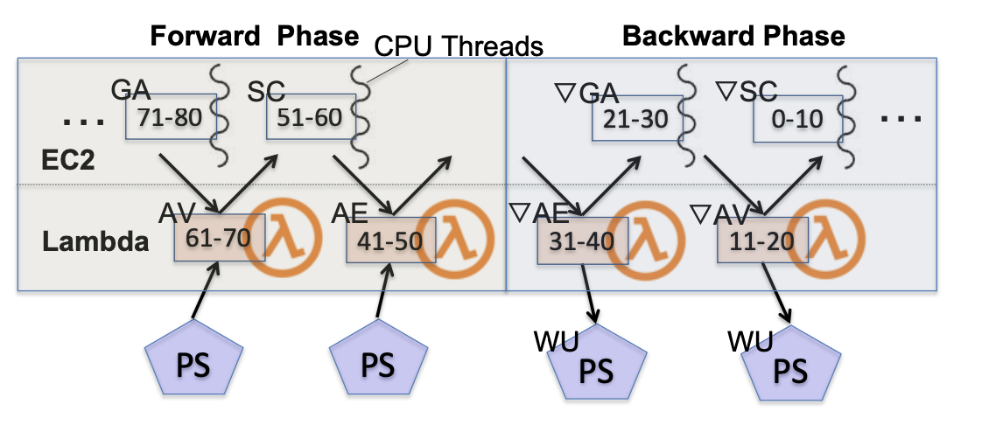
Mini-Batch GNN Execution Model
Dorylus [OSDI’21] pipelines these tasks using task queues
Tasks are executed by CPU threads and serverless threads
Figure from Dorylus [OSDI’21]
Notes:
Recall that each layer contains 9 tasks. So each of these 9 tasks has an associated queue to maintain tasks for each category.
Tasks are fetched and then executed by CPU threads or serverless threads depending on their categories. For example, Gather and Scatter are IO-intensive operations and therefore are executed by CPU threads in EC2 servers.
ApplyVertex and its backward version are basically matrix multiplication, which are computational-intensive, and therefore is executed by serverless threads.
If you don’t know what serverless thread is, you can just think of them as a thread with low computational-power but you can use them with an extremely low price. So you can have millions of these serverless threads in order to achieve relatively high parallelism.
In Dorylus, in order to maximize training efficiency, the workers/threads will not wait for the completion of the last mini-batches and weight updates. In other words, as long as there’re remaining tasks in task queues, it will try to fetch them and start the computation immediately.
[CLICK]
For example, the mini-batch pointed by the red arrow is in the middle of weight update.
[CLICK]
But the mini-batch pointed by the blue arrow is already starting ApplyVertex. So you can see the task scheduling order is quite relaxed and random.
Therefore, this work describes a highly asynchronous training pipeline but in the meantime not losing signification accuracy. And we will talk more on the asynchoronous training and staleness tolerance in the following slide.

Slide 32
Agenda
Why Distributed & Challenges
Mini-batch GNN training
Full-graph GNN training
Communication Optimizations
Staleness Tolerance
Optimizations on GPU

Slide 33
Full-Graph GNN Execution Model
NeutronStar [SIGMOD’22] summarizes 2 paradigms of solving vertex dependencies: DepCache & DepComm.
Notes:
We’ve seen some execution models for mini-batch based training pipeline, Now let’s look at how to design the execution model in a full-graph training system.
NeutronStar, appears in SIGMOD’22, summarizes 2 paradigms of solving vertex dependenies in a distributed setting, which are dep Cache and communication Dependency. Vertex dependency is the scenario when a vertex wants to aggregate the feature of its neighbors but some neighbors may locate on another machine. So in order to compute my feature, I need to first request remote features and that’s why vertex dependencies are a severe bottleneck in dist. Gnn training, especially on full-graph training.

Slide 34
Full-Graph GNN Execution Model
NeutronStar [SIGMOD’22] summarizes 2 paradigms of solving vertex dependencies: DepCache & DepComm.
DepCache
3
3
3
Partition 1
2
2
2
2
3
1
1
0
0
+ Good for sparse graph
+ Good for high hidden layer dimension
- Additional storage
- Redundant computation
1
3
3
0
2
Partition 0
1
1
1
0
0
0
Notes:
Let me first explain Dependency Cache. DepCache says when a vertex has remote dependencies on remote machines, it will first cache those remote vertices and their features locally, so that if some vertex depends on this feature, it doesn’t have to request the remote machine anymore. For example, suppose we’re considering a 2-layer GCN, we first partition these 4 vertices in 2 partitions, 0,1 and 2,3.
[CLICK]
If we want to compute the final feature of 1, we notice that it has 2 incoming neighbors, 0 and 3. 0 can be accessed locally, but 3 is in another partition. So we need to find a way to get the feature of vertex 3. The same case happens for vertex 2. It has 3 incoming neighbors, but 0 and 1 are in another partition.
[CLICK]
According to the definition of Dep Cache, we need to cache those dependent vertices. In this example, 2, 3 should be cached in partition 0 since we need them to compute feature for 1 and 3. 0, 1 should be cached in partition 1 since we need them to compute feature for 0, 1 and 2.
[CLICK]
Therefore, a very obvious drawback is it requires additional storage for caching and sometimes the required space can be large. For example in this case, we end up cache all vertices in each partitioning. Also, if you look at the red arrow, the feature of 1 is derived from 0 and 3. This feature is computed twice on two partitions, which means there exists redundant computation is the DepCache paradigm.
But there're also benefit for DepCache paradigm. If the graph is sparse, the number of cached vertices will be small. Besides, if the network design has high hidden layer dimension, we can avoid heavy feature communication through the network.

Slide 35
Full-Graph GNN Execution Model
DepComm
3
3
3
2
3
Partition 1
2
2
2
+ Good for low hidden layer dimension
+ No redundant computation
+ No additional storage
- High demand for fast network
0
1
1
1
1
Partition 0
0
0
0
Notes:
Dependency Communication is another paradigm where we don’t do any caching at all. When a vertex depends on another remote vertex, it will wait until that feature is received from the link of 2 devices, The link can be fast links like NVLink or slow links like PCIe or network.
[CLICK]
In the same example, in partition 0, 1 still depends on 0 and 3. it will wait until it received the feature of 3 sent by partition 1. For vertex 2, it relies on 0 and 1 remotely, so it will also wait until partition 0 sends 0 and 1.
[CLICK]
The first layer also contains feature communication between 2 partitions.
[CLICK]
This DepComm paradigm apparently has no redundant computation, and is desirable if the hidden layer dimension is low, because the communicated feature vector is short. No additional storage is required is this paradigm since we don't cache any vertex at all.
However, we can notice that every layer will likely depends on other partitions. If the data is received by a large latency, the training efficiency is compromised. Therefore, this paradigm has high demand for fast network to reduce the latency for data comm.

Slide 36
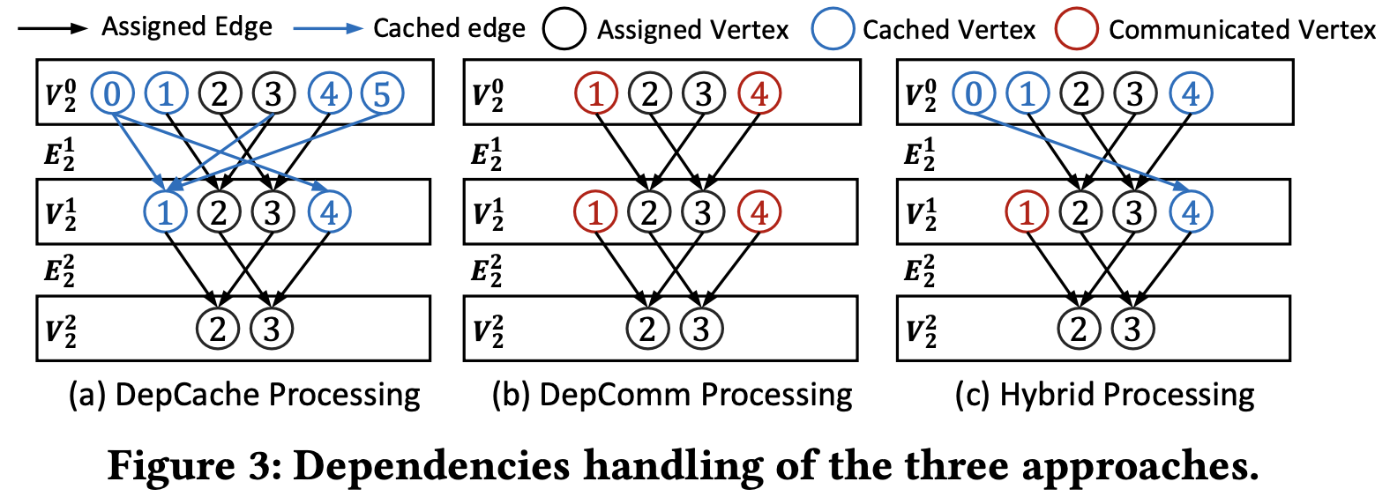
Full-Graph GNN Execution Model
+ Adaptive to diff. graph/network
+ Less redundant computation
+ Less additional storage
+ Less demand for fast network
Hybrid Dependency Management
Figure from NeutronStar [SIGMOD’22]
Notes:
This work notices that these 2 paradigms both have their own pros and cons,
it wants to combine these 2 paradigms in order to kind of get the best from both worlds. Therefore it proposes a novel technique called hybrid dependency management.
For example, in the left figure where depCache is used, blue vertices are cached locally so we can do computation without any trouble.
In the middle figure where depComm is used, red vertices are sent from remote machines so that we can continue computing as long as the dependent features are received.
However, in the hybrid scenario, some vertices are cached locally and the rest of the dependent vertices will be requested remotely.
[CLICK]
For example in the right figure, Vertex 1 is sent remotely while the rest blue vertices are cached.
Regarding the question that which vertices we want to cache or which vertices we need to remotely request, you can check out this paper where they introduces a heuristic way to determine.
[CLICK]
The hybrid management is obviously better than 2 individual paradigms, because it's adaptive to different input graphs and network design. We just need to run the heuristic algorithm in the paper and we can obtain the best strategy for the ratio of caching and communication nodes.
Besides, we have less redundant computation, we need less additional storage. We don't need very fast network in the hybrid scenario.

Slide 37
Agenda
Why Distributed & Challenges
Mini-batch GNN training
Full-graph GNN training
Communication Optimizations
Staleness Tolerance
Optimizations on GPU

Slide 38
Communication Optimization
Overlapping Comm. w/ Comp.
NeutronStar [SIGMOD’22]
Faster Links
DGCL [EuroSys’21]
Redundant IO/Data Reuse
HongTu [SIGMOD’24]
Compression by (De)Quantization
AdaQP [MLSys’23], EC-Graph [ICDE’22], F²CGT [VLDB’24], SYLVIE [ICDE’24]
Notes:
As we've introduced the execution model for mini-batch based and full-graph distributed GNN training, it's obvious that communication between 2 devices or communication among multiple devices is frequently utilized. That's why the communication is oftentimes a severe bottleneck compared to DNN training.
A series of works came up with some solutions to alleviate this issue, and we will be looking at 4 representative approaches. They are overlapping comm. w/ comp. using faster links and avoiding redundant IO or reusing data and Quantization.
[CLICK]
We will take 4 recent works as examples to illustrate how these approaches can be applied in distributed GNN training context.

Slide 39
Overlapping Comm. w/ Comp.
Ring-based Communication
Comm
0
 | 0
0
 | 0
0
 | 0
0
 | 0
Comp
Worker 0
Worker 1
Worker 2
Worker 3
Notes:
Recall that All2All broadcast is widely used in distributed training pipeline. An efficient implementation for the all2all broadcast is called ring-based communication. The intuition is each worker only send to one worker and received from one worker in each round. So that we can avoid congestion and contention in data communication.
For example, suppose we have 4 workers here to do the all2all broadcast. In the first round, the order is defined as worker 0 to 1, 1 to 2, 2 to 3 and 3 to 0. In this example, Worker 0 send the data in green to worker 1, worker 2 send grey data to worker3.
[CLICK]
Worker 1 send orange data to worker 2. and worker 3 send blue data to work 0.

Slide 40
Overlapping Comm. w/ Comp.
Ring-based Communication
Comm
0 | 1
 | 0 | 1
0 | 1
 | 0 | 1
0 | 1
 | 0 | 1
0 | 1
 | 0 | 1
Comp
Worker 0
Worker 1
Worker 2
Worker 3
Notes:
[CLICK]
In the next round, we let worker 0 and 2 exchange data and 1 and 3 exchange data.
[CLICK]
Besides, when the data in the first round is received, each worker can start computation immediately in the current round. By doing this we can overlap the comm w/ comp. to achieve better efficiency.

Slide 41
Overlapping Comm. w/ Comp.
Overlapping Comm. with Comp.
Comm
0 | 1
 | 0 | 1
0 | 1
 | 0 | 1
0 | 1
 | 0 | 1
0 | 1
 | 0 | 1
Comp
Worker 0
Worker 1
Worker 2
Worker 3
Notes:
[CLICK]
In the next round, we let worker 0 and 2 exchange data and 1 and 3 exchange data.
[CLICK]
Besides, when the data in the first round is received, each worker can start computation immediately in the current round. Therefore we can overlap the comm w/ comp. to achieve better efficiency.

Slide 42
Communication Optimization
Overlapping Comm. w/ Comp.
NeutronStar [SIGMOD’22]
Faster Links
DGCL [EuroSys’21]
Redundant IO/Data Reuse
HongTu [SIGMOD’24]
Compression by (De)Quantization
AdaQP [MLSys’23], EC-Graph [ICDE’22], F²CGT [VLDB’24], SYLVIE [ICDE’24]

Slide 43
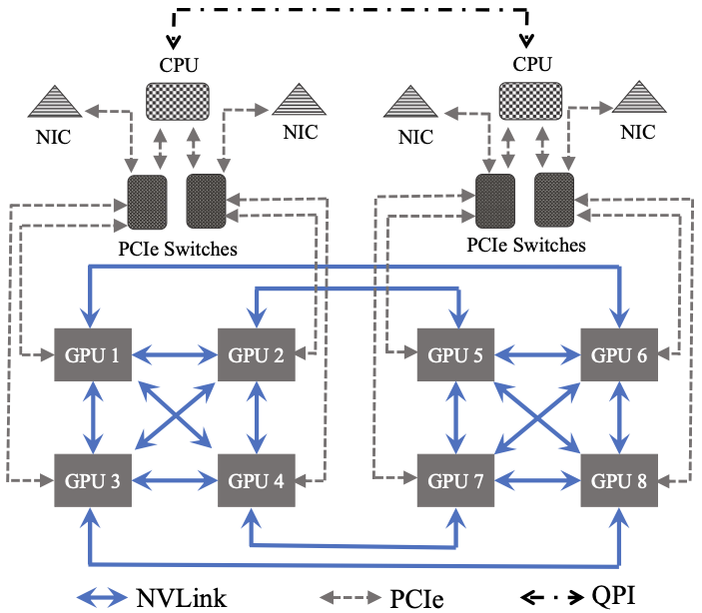
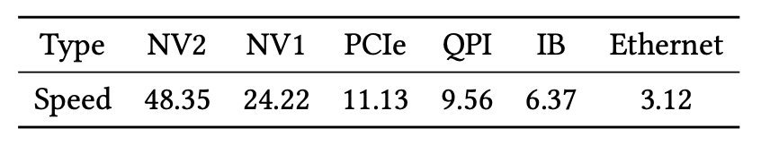
Faster Links
DGCL [EuroSys’21] uses faster links (NVLink) to speed up data communication.
Notes:
The next technique is to use faster links/Nvlinks to speed up data communication, proposed by DGCL in EuroSys’21. This diagrams shows the architecture of how modern CPUs and GPUs are connected and how data flows between CPU and GPU. Specifically, CPUs and GPUs are connected by PCIe link and GPUs internally are connected by a much fast link called NVLink. Modern servers often have more than 1 CPU sockets and in this figure, the server has 2 CPU sockets which are connected by QuickPath Interconnect or QPI. That CPU also has 4 GPUs attached.
If we want to send data from GPU 1 to GPU 6, we can directly use NVLink.
[CLICK]
This table show the bandwidth for various links connecting different hardward. We can see that NVlink is the fastest, then followed by PCIe and QPI, the network is the slowest.

Slide 44
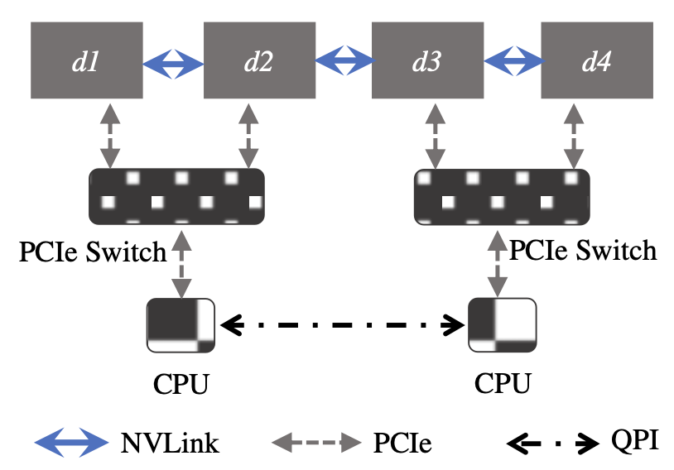
Faster Links
Planning Principles
Utilize fast links (d1 to d3)
Notes:
This paper introduces several principles on how to plan and schedule these communication.
I will introduce them one by one.
The first principle is utilizing faster links. For example, if we want to send data from d1 to d3, we have 2 options.
[CLICK]
One option is highlighted in red where d1 can send data to its CPU through PCIe and send to another CPU through QPI and to d3 through PCIe again.
[CLICK]
The other option is highlighted in yellow where d1 can send data to d2 through NVLink and then to d3 through NVLink again.
Obviously the NVlink option is much better then PCIe-QPI route since it has higher bandwidth and thus lower latency.

Slide 45
Faster Links
Planning Principles
Fuse Communication (d1 to d2, d3 separately)
Notes:
The second principle is called fuse communication.
For exmaple, if we want to send data from d1 to d2 and d3 separately. A straightforward way is to let d1 send to d2 through NVlink and d1 to d3 through PCIe-QPI-PCIe route.
[CLICK]
However, we could have saved some bandwidth by fusing 2 routes into a single route. A more efficient way is to let d1 send to d2 and d2 to d3, so that d2 and d3 can receive the same data.

Slide 46
Faster Links
Planning Principles
Avoid Contention (d1 to d3, d2 to d4)
Notes:
The third principle is to avoid contention.
Suppose we want to send data from d1 to d3 and d2 to d4,
[CLICK]
we can notice that the link from d2 to d3 is shared for 2 routes. Therefore, we need to consider such scenario where a link is shared by multiple routes so the amount of data transferred on the link is way beyond its bandwidth. This link is likely to become a bottleneck and we need to prevent such scenario.

Slide 47
Faster Links
Planning Principles
Balance loads on different links (d1 to d3 via both NVLink & PCIe-QPI)
Notes:
The last principle is to balance workloads on different links. Suppose we want to transfer large amount of data from d1 to d3. Rather than relying on only 1 route to transfer all the data, we can divide the data, and let part of the data use the NVLink and the rest of data use the PCIe-QPI-PCIe route. By doing this, we can fully exploit the bandwidth for such heavy data movement and minimize the network latency.

Slide 48
Faster Links
Transform into a link graph
d1
d4
CPU0
CPU1
d2
d3
Notes:
Given all these principles, how do we actually formulate this problem in a mathmatical form?
Firstly, we can transform the hardware architecture into a link graph where each node represents a device, and the edge between 2 nodes is the link between them. For example, d1 to d4 are 4 GPUs which are partially connected by NVLink. Each CPU has 2 GPUs attached to it. These 2 CPUs are internally connected by QPI.

Slide 49
Faster Links
Shortest path problem (Dijkstra’s algorithm)
v
d1
d4
5
6
8
2
CPU0
CPU1
4
5
5
d2
d3
3
Notes:
Now suppose we want to send the feature of v from d1 to d3, which route is the most efficient? We can assign a cost value to each edge describing the cost we need to pay if the data is sent through this link. This value is related to the bandwidth of the link and the amount of data that has been assigned to this link.
Since we know the source is d1 and destination is d3, we can run a Dijkstra algorithm to find the shortest path between these 2 nodes such that the cost is minimized. We can record this shortest path as part of the plan. After the plan is determined, we will start actual data communication.

Slide 50
Communication Optimization
Overlapping Comm. w/ Comp.
NeutronStar [SIGMOD’22]
Faster Links
DGCL [EuroSys’21]
Redundant IO/Data Reuse
HongTu [SIGMOD’24]
Compression by (De)Quantization
AdaQP [MLSys’23], EC-Graph [ICDE’22], F²CGT [VLDB’24], SYLVIE [ICDE’24]

Slide 51
Redundant IO/Data Reuse
HongTu [SIGMOD’24] maintains vertex embeddings on CPU and offloads computation to GPU.
GPU 0
GPU 1
GPU 2
GPU 3
1
0
0
2
1
4
0
6
Batch 0
3
3
3
4
7
4
Batch 1
Vertex 3’s feature vector is loaded 3 times to GPUs
through slow PCIe!
Redundant IO!
Notes:
Now let’s talk about Redundant IO or Data Reuse. HongTu in SIGMOD’24 introduces a scenario where the vertex embedding is stored in the CPU memory. It offloads the computation to GPU and copy the necessary vertex embedding from CPU to GPU in every batch.
For example, suppose we have 4 GPUs here and each GPU is assigned with 1 vertex and it requires some dependent features. In the most straightforward approach, the CPU will copy the data 4 times, each time to 1 GPU.
[CLICK]
However, since the vertex 3 is required by GPU 0,1 and 3, its feature is repeatedly loaded 3 times to GPUs through the slow PCIe link.
[CLICK]
That’s why there exists redundant IO in the CPU-GPU data copying. And this work aims to get rid of such redundant IO.

Slide 52
Redundant IO/Data Reuse
Inter-GPU Communication
GPU 0
GPU 1
GPU 2
GPU 3
0, 1
2, 3
4
7
No redundant IO!
Inter-GPU broadcast
through fast NVLink
1, 3, 4
0, 3, 7
1
0, 3, 4
Batch 0
1
0
0
2
1
4
0
6
3
3
3
4
7
4
Notes:
The work introduces inter-gpu comm where on the CPU side, it loads each vertex only once even if a vertex is required by more than 1 GPU, like vertex 3 in this case.
Then the GPUs can internally do an all2all broadcast to feed each device with necessary data. This broadcast is done through the fast NVLink, rather than the slow PCIe link.
[CLICK]
This solution not only get rid of redundant IO but also speeds up data comm w/ faster links.

Slide 53

Redundant IO/Data Reuse
Intra-GPU Data Reuse
GPU 0
GPU 1
GPU 2
GPU 3
0, 1
2, 3
4
7
Batch 0
1, 3, 4
0, 3, 7
1
0, 3, 4
2, 3
4
5
6
CPU
Batch 1
Broadcast
6
2, 5, 6
2, 4
2, 3, 6
Notes:
We just talk about redundant IO inside a single batch. There’re also opportunities to reuse the data between consecutive batches.
For example, now in the case, the workload for the next batch is shown. We can observe that vertex 2 and 3 is used also in the next batch, and the good news is we’ve already load them in the previous batch.
[CLICK]
Therefore, we don’t have to load vertex 2 and 3 again, we can just reuse the data from previous batch.
[CLICK]
The same happens on vertex 4. We can also reuse vertex 4’s data rather than loading it again.
[CLICK]
But vertex 5 is not the case so we need to load vertex 5 from CPU.
This technique is called intra-GPU data reuse because it happens only in the same device between consecutive batches.

Slide 54
Communication Optimization
Overlapping Comm. w/ Comp.
NeutronStar [SIGMOD’22]
Faster Links
DGCL [EuroSys’21]
Redundant IO/Data Reuse
HongTu [SIGMOD’24]
Compression by (De)Quantization
AdaQP [MLSys’23], EC-Graph [ICDE’22], F²CGT [VLDB’24], SYLVIE [ICDE’24]

Slide 55
(De)Quantization: AdaQP [MLSys’23]
Vanilla Communication
Quantized Communication
Comm.
Comp.
Comm.
Quan
Comm.
DQuan
Comp.
Quan
Comm.
DQuan
Comp.
Comp.
over local data
Notes:
If we look at the vanilla communication, each device/machine will first wait the remote data to come and after it receives those data, it starts to do the computation. And then followed by another communication for the next layer.
[CLICK]
For the quantized communication, every time before a machine sends some message, it will first quantize the data on the GPU, for example from float32 to a 2-bit integer. And then it will send the quantized message to others. When a receiver receive some message from a machine, it will then dequantized the message in order to recover the real message. Of course some meta data will also be sent for the receiver to decipher the message. After the data is dequantized, it can start computing the data.
Notice that in the blue rectangle, it can compute the local data because every thing can be accessed locally. So we can see a small pipelining here to overlap to comm. with comp.

Slide 56
(De)Quantization: AdaQP [MLSys’23]
Stochastic Integer Quantization (2-bit integer as example)
Dequantization
Adaptive quantization
Earlier epochs need less bits (e.g., {2, 4}-bits)
Later epochs need more bits (e.g., 8-bits, original message)
[1.5, 3.3, 2.5, 0.9]
Step = (3.3 – 0.9)/3 = 0.8
[0.6, 2.4, 1.6, 0]
[0.75, 3, 2, 0]
[1, 3, 2, 0]
[0.8, 2.4, 1.6, 0]
[1.7, 3.3, 2.5, 0.9]
Notes:
let's see a concrete example of how to quantize a vector with floating point numbers. The method we will be using is called stochastic integer quantization. We'll use a 2-bit integer as an example.
For example, .....
For dequantization,
[CLICK]
if we use the same example, ...

Slide 57
(De)Quantization: EC-Graph [ICDE’22]
Send non-compressed embeddings H every T iterations
Also send the embedding change rate (H^{t+T} – H^{t}) / T
Each iteration, for each vertex, only send the most accurate representation among:
Quantized H
Predicted H by prior non-compressed H and change rate
Their average
When adopting predicted embedding, can skip sending
Need to send control bit on the selection (00, 01, 10)

Slide 58
(De)Quantization: F²CGT [VLDB’24]
For mini-batch GNN training
CPU for subgraph sampling
Features are loaded to GPU for computing
Optimization: on-GPU cache
Based on “hotness” of neighbor lists or node embeddings
Log-uniform scalar quantization for sampling seed nodes (smaller error)
Vector quantization for nodes other than seeds (higher compression ratio)
k-means with cosine similarity

Slide 59
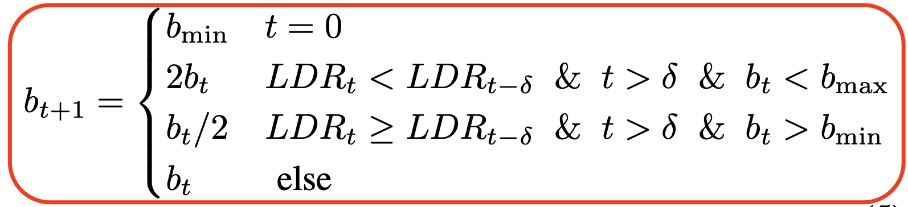
(De)Quantization: SYLVIE [ICDE’24]
Dynamic Per-Node Quantization
Offline data-adaptive: high indegree larger bitwidth
Online time-adaptive: Loss Descent Rate drops bitwidth lower bound increases & switch from async to sync
Notes:
async = staleness

Slide 60
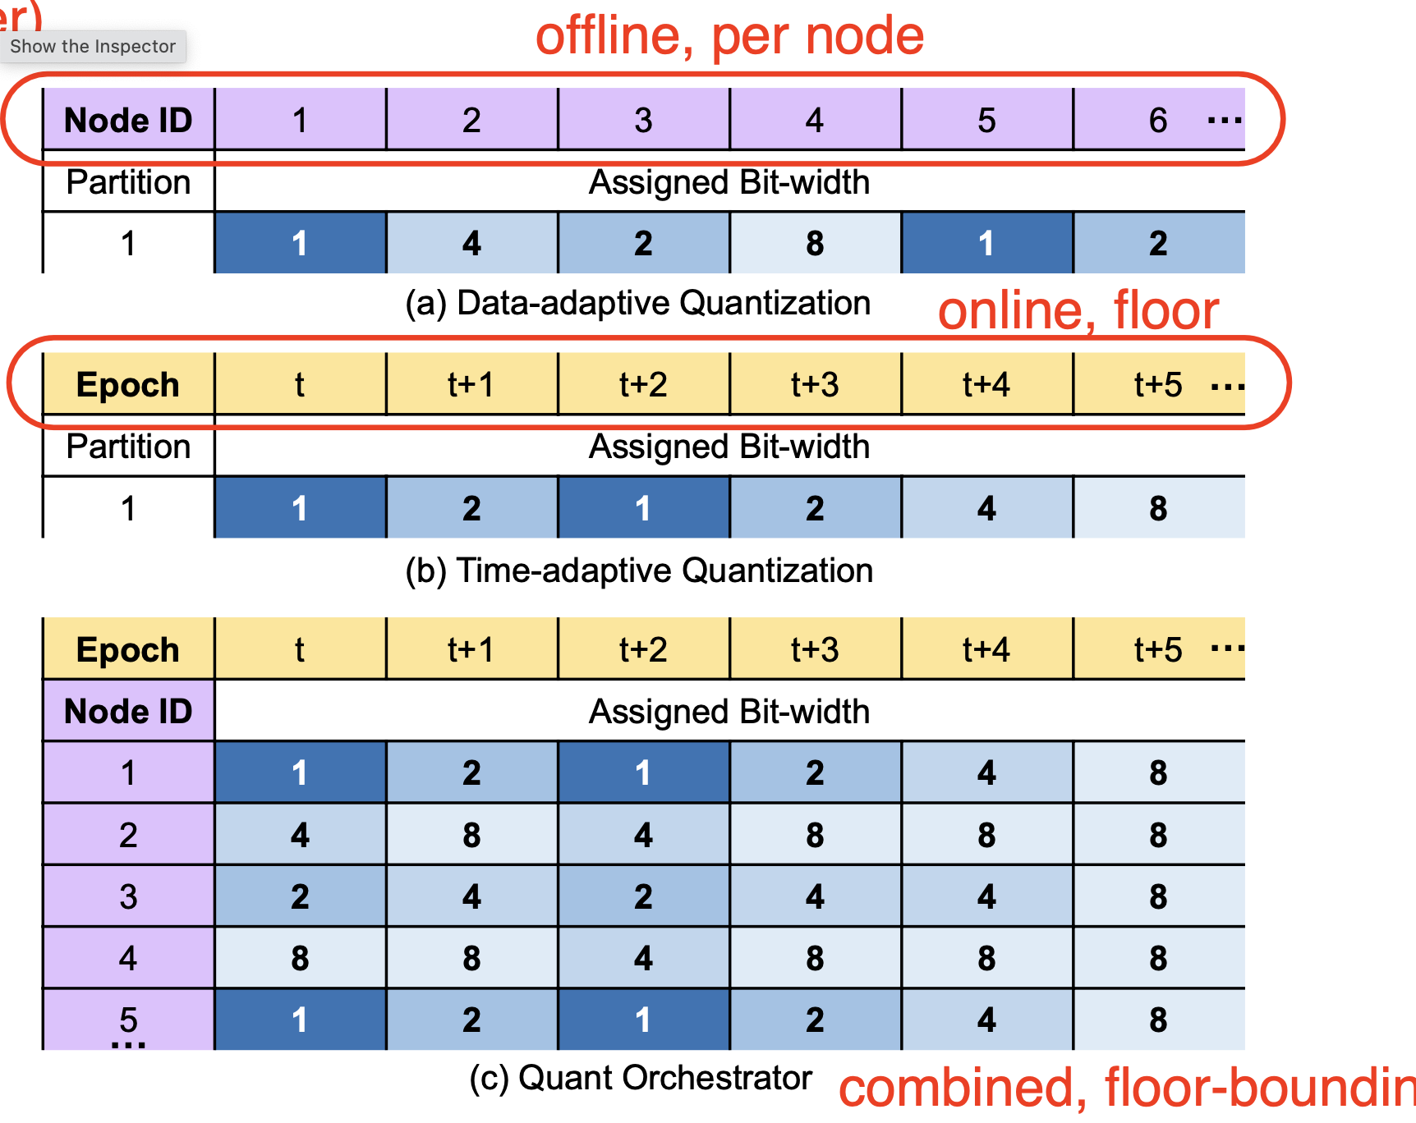
(De)Quantization: SYLVIE [ICDE’24]
Dynamic Per-Node Quantization

Slide 61
Agenda
Why Distributed & Challenges
Mini-batch GNN training
Full-graph GNN training
Communication Optimizations
Staleness Tolerance
Optimizations on GPU

Slide 62
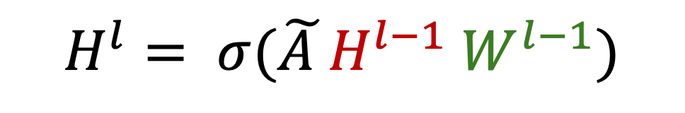
Staleness Tolerance
$$H^{l}= σ(\tilde{A }H^{l−1} W^{l−1})$$
Embedding Staleness
DistGNN [SC’21]
Sancus [VLDB’22 best paper]
Weight/Gradient Staleness
P3 [OSDI’21]
Dorylus [OSDI’21]
Notes:
Staleness is an interesting problem which inspires a series of GNN system papers. Roughly speaking, it can be split into 2 categories, namely embedding staleness and weight/gradient staleness. The reason some systems tolerates staleness in training is either they want to reduce the amount of data that are broadcast to reduce IO bottleneck or they support highly asynchronous training pipeline in order to maximize the efficiency.
[CLICK]
For embedding staleness, we will talk about DistGNN and Sancus. Btw, Sancus won the best paper award in VLDB’22 so you can see that it’s very hot topic. And for weight/gradient staleness, P3 and dorylus will be covered.

Slide 63
Embedding Staleness
DistGNN [SC’21] proposes Delayed Remote Partial Aggregates.
I need to aggregate features from 3 remote machines!
After Partitioning
GPU 0
GPU 1
GPU 2
GPU 3
Notes:
DistGNN in SC'21 employs a very simple staleness design. Suppose we have an input graph and after partitioning into 4 parts, we obtain the result on the right.
[CLICK]
Now in the GPU1, in order to do the forward propagation, this vertex need to aggregate feature from 3 remote machines which can be a severe bottleneck. So this paper proposes a technique called delayed remote partial aggregates.

Slide 64
Embedding Staleness
Each remote vertex starts communication in epoch 𝑖 and asynchronously receives and processes aggregates in epoch (𝑖 + 𝑟).
I receive and aggregate at Epoch 5.
GPU 0
GPU 1
Epoch 5
GPU 2
GPU 3
I send my features of Epoch 3.
Notes:
What this means is each remote vertex starts communication in epoch i and asynchronously receives and processes aggregates in epoch i + r.
[CLICK]
For example, Suppose we are at Epoch 5 right now.
GPU 3 send its feature to GPU 1 at Epoch 3 and this feature will be used and aggregated at Epoch 5. So we tolerate stale embeddings from 2 epochs ago and these 2 epochs’ time can be used to do data communication in case the network is congested or slow.

Slide 65
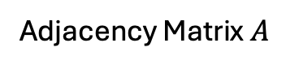
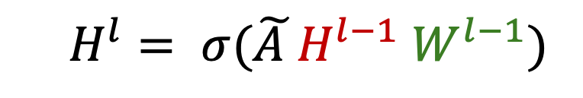
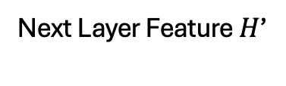
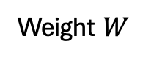
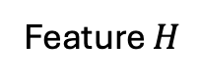
Embedding Staleness
Sancus [VLDB’22]
A₀
A₁
=
A₂
A₃
Adjacency Matrix $A$
Feature $H$
Weight $W$
Next Layer Feature $H$’
$$H^{l}= σ(\tilde{A }H^{l−1} W^{l−1})$$
Notes:
Sancus in VLDB’22 employs a more fine-grained staleness control. Recall that the forward propagation is formulated as adjacent matrix A times vertex embedding H times weight matrix W and we can obtain the vertex embeddings for next layer.

Slide 66
Embedding Staleness
Sancus [VLDB’22]
A₀
H’₀
A₁
H’₁
=
A₂
H’₂
H’₃
A₃
Adjacency Matrix $A$
Feature $H$
Weight $W$
Next Layer Feature $H$’
$$H^{l}= σ(\tilde{A }H^{l−1} W^{l−1})$$
Notes:
If we partition this adjacent matrix horizontally into 4 parts, then the result will also be partitioned into 4 parts, each parts corresponds to 1/4 of the input adjacency matrix.

Slide 67
Embedding Staleness
Adjacency-matrix partitioning
A₀
A₁
A₂
A₃
H
W
H
W
H
W
H
W
H’₀
H’₁
H’₂
H’₃
GPU 0
GPU 1
GPU 2
GPU 3
Notes:
Sancus first partition the adjacency matrix into 4 sub-matrices a0 a1, a2 and a3 assume we have 4 GPUs. In other words, each GPU maintains 1/4 of the total vertex.
[CLICK]
Then each GPU starts the computation based on its partial adjacent matrix, the result would be the partial vertex embeddings for the next layer.
In order to compute for the next layer, each GPU has to do an all2all broadcast to exchange their partial H’.

Slide 68
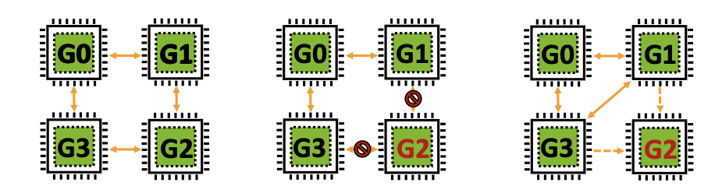
Embedding Staleness
We need AlltoAll broadcast to communicate H’₀ H’₁ H’₂ H’₃
Sancus proposes Skip-Broadcast
H’₂ in G0, G1, G3 are stale
Heavy IO!
Less IO!
Figure from Sancus [VLDB’22]
Notes:
So we need all2all broadcast to communicate H0', H1', H2', H3' such that each GPU has the result of the complete H’,
[CLICK]
But this leads to heavy data shuffling.
[CLICK]
Therefore Sancus propose Skip-Broadcast.
[CLICK]
What this means is if we don’t tolerate any staleness, we would do a complete broadcast just like the left fig.
If we can skip some broadcast, for example in the middle figure, G2 decided not to broadcast its H2’ to others.
[CLICK]
So the H2' in the rest GPUs G0, G1 and G3 will be stale.
[CLICK]
But the good news is we skip several broadcast and get less IO to save some bandwidth.

Slide 69
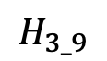
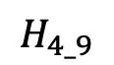
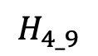
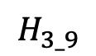
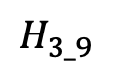
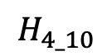
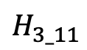






































Embedding Staleness
GPU 0
GPU 1
GPU 2
GPU 3
GPU 0
GPU 1
GPU 2
GPU 3
GPU 0
GPU 1
GPU 2
GPU 3
$$H_{1_9}$$
$$H_{1_8}$$
$$H_{1_8}$$
$$H_{1_8}$$
$$H_{1_10}$$
$$H_{1_8}$$
$$H_{1_8}$$
$$H_{1_8}$$
$$H_{1_11}$$
$$H_{1_11}$$
$$H_{1_11}$$
$$H_{1_11}$$
$$H_{2_7}$$
$$H_{2_9}$$
$$H_{2_7}$$
$$H_{2_7}$$
$$H_{2_10}$$
$$H_{2_10}$$
$$H_{2_10}$$
$$H_{2_10}$$
$$H_{2_10}$$
$$H_{2_11}$$
$$H_{2_10}$$
$$H_{2_10}$$
$$H_{3_9}$$
$$H_{3_9}$$
$$H_{3_9}$$
$$H_{3_9}$$
$$H_{3_9}$$
$$H_{3_9}$$
$$H_{3_10}$$
$$H_{3_9}$$
$$H_{3_9}$$
$$H_{3_9}$$
$$H_{3_11}$$
$$H_{3_9}$$
$$H_{4_9}$$
$$H_{4_9}$$
$$H_{4_9}$$
$$H_{4_9}$$
$$H_{4_9}$$
$$H_{4_9}$$
$$H_{4_9}$$
$$H_{4_10}$$
$$H_{4_9}$$
$$H_{4_9}$$
$$H_{4_9}$$
$$H_{4_11}$$
Epoch 9
Epoch 10
Epoch 11
Notes:
Suppose we are at Epoch 9, Since the full embedding matrix comes from 4 parts, we can see that each GPU maintains 4 separate embeddings. For example in GPU 0, H1_9 stands for the first part is computed from Epoch 9, H2_7 stands for the second part is computed from Epoch 7. If we tolerate embeddings from last 2 epochs at most, H2_7 is already on the edge of being overly stale and invalid.
[CLICK] So the next epoch, GPU1 will broadcast it latest H2_10 to others so that every one can get a newer version of H2. Now the H1 kept in the rest 3 GPUs are on the edge on being overly stale and invalid,
[CLICK]
So at Epoch 11, GPU 0 will broadcast its latest H1 to others so that every one can get a newer version of H1. And now H3 and H4 are on the edge so they must be updated in the following epoches.
This work also introduces some definitions on how to determine if a H is overly stale or not, you can check out their papers for more details.

Slide 70

Weight Staleness
P3 [OSDI’21] introduces staleness by pipeline delay
Regular: $w_{t+1}=w_{t}−η ∇f(w_{t})$
Pipelined delayed: $w_{t+1}=w_{t}−η ∇f(w_{t−3})$
Notes:
Now let move onto the weight staleness or gradient staleness since the computation of gradient must rely on the current weight. If the weight is already stale, the gradient must be stale as well.
P3 introduces staleness by adopting a technique called pipeline delay which is inspired by traditional DNN training. In the most regular form, the gradient is obtained using the current weight, and we can do a weight update based on this gradient.
But in the pipelined delayed version, the gradient is computed using the weights from 3 mini-batches ago.

Slide 71
Mini-Batch GNN Execution Model
D
|V|
M1
M2
M3
M4
P3 [OSDI’21] introduces Push-Pull Parallelism.
Embedding Matrix
Recall P3’s Pipeline
shuffling k-hop subgraphs only
hidden features
(~100 dimension)
Notes:
Let’s first recall P3’s training pipeline. For every mini-batch, the first layer of GNN uses the model parallelism, where each machine is in charge of 1/4 of the total dimension. Then followed by an all2all broadcast to communicate hidden features, such that every machine can obtain a complete hidden embedding matrix for an individual mini-batch. Then the model moves into the data parallelism all the way to the end.

Slide 72

Weight Staleness
P3 [OSDI’21] introduces staleness by pipeline delay.
Regular: $w_{t+1}=w_{t}−η ∇f(w_{t})$
Pipelined delayed: $w_{t+1}=w_{t}−η ∇f(w_{t−3})$
Recall P3’s pipeline
Model Parallelism
Data
Communication
Data Parallelism
Forward
Model Parallelism
Data
Communication
Data Parallelism
Backward
Notes:
This simplified figure abstracts P3's pipeline. On the forward propagation side, we have model parallelism, the data communication, and data parallelism. And on the backward propagation side, the operations are reversed. So we have data parallelism, followed by data communication and model parallelism.

Slide 73

Weight Staleness
P3 [OSDI’21] introduces staleness by pipeline delay.
Regular: $w_{t+1}=w_{t}−η ∇f(w_{t})$
Pipelined delayed: $w_{t+1}=w_{t}−η ∇f(w_{t−3})$
For example, in mini-batch #3,
3_{M}
Data
Communication
3_{D}
Forward
3_{M}
Data
Communication
3_{D}
Backward
Notes:
Let’s use some notations to represent these steps. Suppose we’re in mini-batch #3, 3M represents the model parallelism in mini-batch 3, and 3D represents the data parallelism in mini-batch 3.
You can also think of the arrow as a dependent relationship between 2 phases. Only the previous phase is completed, the next phase will be started.

Slide 74


Weight Staleness
Overlap Comm. w/ Comp.
$$w_{4}=w_{0}−η ∇f\left(w_{1}\right)$$
$$w_{5}=w_{4}− η ∇f(w_{2})$$
P3 [OSDI’21] employs pipelining mechanism to schedule 3 mini-batches.
Notes:
P3 schedule 3 mini-batches simultaneously in order to hide the data communication latency.
For example, if we look at red arrow in the figure, 3D relies on 3M. So the time in between can be used to launch the data communication. In the backward version, 3M relies on 3D, So the time in between can be used to launch the gradient communication.
[CLICK]
So by using the pipelining mechanism, we can overlap comm w/ comp and hide its latency.
[CLICK]
If we look at the red square, the forward pass of min-batch 4 is right after the weight update of mini-batch 1.
so, the update looks like w4 which is the weight that will be used in mini-batch 4, equals to the initial weight w0, minus the gradient of mini-batch 1 times a learning step.
[CLICK]
As another example, If we look at the purple square, the forward pass of min-batch 5 is right after the weight update of mini-batch 2.
so, the update looks like w5 which is the weight that will be used in mini-batch 5, equals to the last weight w4, minus the gradient of mini-batch 2 times a learning step.

Slide 75

Weight Staleness
In Dorylus [OSDI’21], to reach full-power of training, workers do not need to wait for updates to proceed.
Working on multiple
mini-batches concurrently
Different weights among Parameter Servers
Notes:
Recall that dorylus introduces a highly asynchronous training pipeline using the cloud computing platform like AWS to reach full-power of training.
[CLICK]
We can observe that the Lambda/serverless threads are working on multiple mini-batches concurrently, so there must be some threads using stale weight. For example, if you look at red arrow, some threads are working on vertices 11-20, while some threads are working on vertices 31-40.
[CLICK]
Besides, the weight matrix maintained in these parameter servers may not be exactly same to each other, so these parameter servers need to do an internal synchronization periodically. So those weight matrices kept in PSes may be stale before a synchronization round.

Slide 76
Agenda
Why Distributed & Challenges
Mini-batch GNN training
Full-graph GNN training
Communication Optimizations
Staleness Tolerance
Optimizations on GPU

Slide 77

Optimizations on GPU
Challenges of training GNNs on GPU stem from irregular access pattern on graphs
Workload Partitioning & Assignment
Block
Warp
Thread
Memory Access
Shared Memory
Global Memory
Coalesced Memory Access
Notes:
Ok, the last topic we will be discussing is some specialized optimization technique on GPUs. GPUs are widely used in training Deep Networks, such as computer vision, language models and graph neural networks. Sometimes we tend to ignore the existence of these GPU hardware because those deep learning frameworks like PyTorch or DGL already wraps these details into high-level functionalities. But they are basically general frameworks, which implies they may not have dedicated optimizations for the specific model that we're using, for example GNN in this tutorial. Therefore, this section we're interested in those tailored optimizations for GNN on GPUs.
[CLICK]
The challenges of training GNNs on GPU or generally speaking most traversal problems on graph on GPU stem from irregular access patterns. Since the neighbor may locate very far from the vertex, traversing on graph become a random memory access. Furthermore, you have multiple CPU/CUDA threads traversing in a graph, the memory access will be even more random. But we know that coalesced memory access can better utilize the cache and therefore more efficient. So based on this observation, we need to carefully design the behaviors of GPU to better utilize the hardware.
[CLICK]
The first thing we need to focus in known as workload partitioning and assignment. The architecture of GPU is shown on the slide. It consists of several hierarchies of the processing unit. Each hierarchy has different levels of computational-power. For example, Thread is on the lowest level. A warp consists of 32 threads which is executed in a SIMD manner on SMs. So warp scheduler will choose a warp and SM will then execute this warp. A block or thread-block often contains 4-32 warps depending on the configurations.
[CLICK]
Another thing to focus is the memory access which oftentimes can be a bottleneck in optimizing your program. We have large space called global memory where every processing unit can access as long as the address is known, but it's a little bit slower. So each block has a space called shared memory which has higher bandwidth and lower latency.

Slide 78


Optimizations on GPU
GNNAdvisor [OSDI’21] introduces workload partitioning on 2 dimensions.
Neighbor Partitioning
What if a node has high degree?
Notes:
Let's first focus on the problem of workload partitioning for GPUs. GNN advisor in OSDI'21 claims that the workload of propagating/training a vertex comes from 2 dimensions, which are # of neighbors and size of feature dimension. So we can partitioning the workload w.r.t. these 2 dimensions. Let's first discuss the neighbor partitioning.
This figure shows an input graph and its CSR format stored in GPU memory. The yellow nodes highlight the nodes we will propagate, and their neighbors are highlighted in red in CSR. A straightforward way to partition is we let each warp handles one node. For example, ...
[CLICK]
However, What if a node has very high degree such that the warp assigned to this node will take a much longer time than other warps? This causes workload imbalance and straggler problems. So how shall we handle this extreme degree situation?

Slide 79

Optimizations on GPU
+ Mitigate workload irregularity (compared w/ NP)
+ Avoid tiny workloads (compared w/ EP)
Neighbor Partitioning
Equal-sized
Neighbor Groups (NG)
Notes:
This work came up with a simple solution to further break down the neighbors of each vertex. In the same example, NP-0 stands for the neighbor partition of node 0, which is all neighbors of node 0. NP-1 stands for all neighbors of node 1.
[CLICK]
This work further splits the neighborhood of a node into several equal-sized neighbor groups (NG). If we assume the size of each NG to 2 in this case, node 0 has 4 neighbors, so it's splited into 2 NGs. Node 1 has 2 neighbors, so 1 NG is enough. Node 2 has 6 neighbors, so it will be splited into 3 groups.
[CLICK]
Compared to Neighbor Partitions (NP), Neighbor Group can balance each partition contains roughly the same workload so it can mitigate irregular workload caused by the extreme degrees.
[CLICK]
Compare with Edge-Partitions (EP) where each edge is treated as a partition, this is obviously more fine-grained than NG, but it brings numerous tiny workloads which makes GPU/SM hard to schedule and incurs additional overhead.
Therefore, NG has clear advantages over 2 other options NP and EP.

Slide 80

Optimizations on GPU
Dimension Partitioning
Each thread only aggregate one dimension
Notes:
Second dimension comes from the dimension. During the aggregation phase, we need to get the features of all neighbors and cumulatively aggregate on each dimension.
[CLICK]
Therefore in order to do the dimension partitioning, we let each thread only aggregate 1 dimension so that the workload can be evenly scattered.

Slide 81
Optimizations on GPU
+ Reduce ~40% of memory access
+ ~1.5x speedup
GNNAdvisor [OSDI’21] adopts 2 memory access optimizations.
Community-aware Node ID Renumbering
Nodes in a cluster have consecutive IDs
NG of consecutive node IDs have closer warp IDs
More likely to be
scheduled on the
same SM
Share L1 cache
on common neighbors
See their paper for the renumbering approach
Notes:
GNNadvisor published in OSDI'21 adopts 2 memory access optimizations to speedup read and write operations.
First technique is community-aware node ID renumbering. In other words, we can first reID all the vertices based on their topology.
[CLICK]
How to intuitively understand this is after clustering and renumbering, nodes in a cluster tend to have consecutive and closer IDs.
[CLICK]
Then the NG of those closer node IDs will be assigned with a closer warpID.
[CLICK]
The closer warpID are more likely to be in a same block and therefore to be scheduled on a same SM.
[CLICK]
Each SM will have their own L1-cache, and nodes in the same community/cluster have more common neighbors, so those common neighbors are saved in L1-cache and can be reused, you don't have to read from the global memory again.
[CLICK]
As a preprocessing step, we want this renumber to be as fast as possible, you can check out their paper for more details.
[CLICK]
From the experimental study, such renumbering approach can reduce 40% of global memory access and gives a 1.5 time speedup.

Slide 82
Optimizations on GPU
Warp-aware Memory Customization (a.k.a. how to use shared memory on GPU)
Node 0
Node 1
Node 2
Warp 0
NG-0
Warp 1
NG-1
Warp 2
NG-2
Warp 3
NG-3
Warp 0
NG-4
Warp 1
NG-5
Warp 2
NG-6
Warp 3
NG-7
Block 0
Block 1
Global Memory
Notes:
The next question is how to use shared memory, Shared memory is much faster than global memory access but it's small. So we need to design how to use it and put those very frequently-accessed data in the shared memory.
This figure shows how each NG is assigned to different warps accross 2 blocks. ......
[CLICK]
During the aggregation step, each warp will fetch the feature of some neighbors and accumulate them in the global memory.
For example, node 0 has 2 NGs, so it will accumulate twice.
[CLICK]
....
[CLICK]
....
This looks straightforward, but we don't use shared memory at all. So how do we take the shared memory into consideration?

Slide 83

Optimizations on GPU
Warp-aware Memory Customization (a.k.a. How to use shared memory on GPU)
Node 0
Node 1
Node 2
Warp 0
NG-0
Warp 1
NG-1
Warp 2
NG-2
Warp 3
NG-3
Warp 0
NG-4
Warp 1
NG-5
Warp 2
NG-6
Warp 3
NG-7
Shared Memory
Shared Memory
Global Memory
Notes:
Here's a more clever way to do the aggregation.
In this figure, we have a shared memory in each block. Warps can only access shared memory in their block.
[CLICK]
Features in warp 0 and 1 can be firstly accumulated into shared memory, which will be faster than global memory.
[CLICK]
Then, warp 2 and warp 3 can also use shared memory. However, NG-4 locates in another block, so it cannot access the shared memory in block 0.
[CLICK]
How to solve the problem?
[CLICK]
well, it can accumulate in block 1's shared memory.
[CLICK]
Node 2 can do the same.
[CLICK]
Lastly, results in shared memory will be copied into the global memory. If one node uses multiple shared memory spaces, we will have another accumulation.
To summarize, using shared memory can significantly reduce the number of global memory access and therefore more efficient.

Slide 84


Optimizations on GPU
What about multi-GPUs?
MGG [OSDI’23] proposes GNN-tailored pipeline construction.
Notes:
All the techniques we mentioned can be used in multi-GPUs, but it still requires some additional design efforts in pipelining.
MGG published in OSDI'23, proposed GNN-tailored pipelined construction methods.
....
Yellow means local neighbors, blue means remote neighbors.
[CLICK]
In order to clearly describe which neighbor are local, which are remote, we use 2 CSRs to separate local and remote neighbors.
For example, ...

Slide 85

Optimizations on GPU
Heterogeneity & Granularity-aware Workload Split
Loading Local Neighbors
Aggregate Comp
Loading Remote Neighbors
Loading local Neighbors
Aggregate Comp
Fine-Grained Heterogeneous Workload Partitions
Notes:
After dividing neighbors into NGs, and we further divide them into local NG and remote NG, we have these several workload partitions.
In the local Neighbor partition, we first read them from memory, then we can aggregate them.
In the remote neighbor partition, since it reads from another GPU, the read time will be slower then local read.
Since we break down Neighbors in NG, and not all NG are the same, some are slower, the rest are faster, we call it fine-grained heterogeneous workload partitions.
Each of these workload partitions will be assigned to warps for processing.

Slide 86
Optimizations on GPU
Pipelining Workload Partitions (a.k.a. inter-warp comm. & comp. overlap)
Loading Remote Neighbors
7
6
10
…
Loading Local Neighbors
1
4
0
2
1
5
Aggregate Comp
1
7
0
4
1
Notes:
Having so many small workload partitions, the scheduler in SM can switch between different warps to overlap comm. and comp.
For example,
So, SM can easily pipeline these small workload partitions between different warps, so the utilization ratio of GPU will be very high.

Slide 87
Summary
Mini-batch GNN training
Graph Partitioning
Batch Generation
Execution (model & data parallelism, task queue)
Full-graph GNN training
Execution (DepCache & DepComm)
Communication Optimization
Pipelining & Overlapping Comm. w/ Comp.
Faster Links
Redundant IO/Data Reuse
(De)Quantization
Notes:
Ok, Let's do a quick summary on what we have talk about so far.
[CLICK]
We first introduce mini-batch GNN training which can be divided into 3 steps. graph partitioning, batch generation and its execution model where we talk about model & data parallelism, and also talk queue to support asynchronous training.
[CLICK]
Then we introduce full-graph GNN training where we talk about the pros and cons of DepCache and DepComm, and the hybrid version can get the best of both worlds.
[CLICK]
Then we focus on the communication bottleneck in GNN and introduce 4 representative solutions to reduce communication latency. they are , ......

Slide 88
Summary (Cont.)
Staleness Tolerance
Embedding Staleness
Weight/Gradient Staleness
Optimizations on GPU
Fine-Grained Workload Partitioning and Pipelining
Memory Customization (cache, shared memory)
Inter-warp Pipelining on SM
Notes:
Lastly, we introduce staleness tolerance and its 2 categories, embedding staleness and weight or gradient staleness.
[CLICK]
….
[CLICK]
And this is the end of the tutorial. Thank you all for your attention. If you have any questions, please feel free to let me know. You can contact me at this email, I would like to answer it. Thank you!

Slide 89


Thank you !
Questions?
Da Yan yanda@iu.edu
Notes:
This concludes the first part of the tutorial.
Thanks for your attention, and do you have any questions?

